Slide 1
The secure place to open Restaurant in Nevada

Slide 2
Secure place is a main key for setting restaurant business
The security is the most important and without security no business or any activity can not be done.
In United States there are 3 types of crimes which must be considered before a businessman decide to set office for business
Data might contribute to determine the best location to do business by comparing different states based on the different crimes rate and what type of business to do.
To start a business, it is a must to consider strategic points including competitiveness, location and security which is most important for a businessman who wants a profitable business.
This project aim to help businessmen who want to do restaurant business in Nevada state.
The restaurant is a good business to do in a big city where there are different communities. This project aims to determine a good place to open a restaurant and setup his office in the state of Nevada

Slide 3
Data acquisition and cleaning
Different types of crime data reported in 36 State in 2017 from https://en.wikipedia.org/wiki/List_of_United_States_cities_by_crime_rate.
Those types are: violent crime, property crime and arson crime. In total 100 rows and 13 columns.
Some rows and columns have not considered in the analysis as they don’t included in the in the interested place
Foursquare API helps to collect data to locate different places and get coordinates of states, cities and their neighborhoods
The interested state is Nevada and the analysis is most based on that state that has 121 cities, crimes reported are for four cities. The information is from:
https://www.nevada-demographics.com/cities_by_population
http://www.city-data.com/nbmaps/neigh-Henderson-Nevada.html.

Slide 4
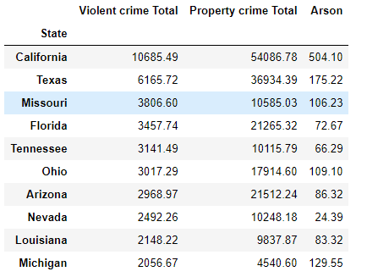
Crimes in different States

Slide 5
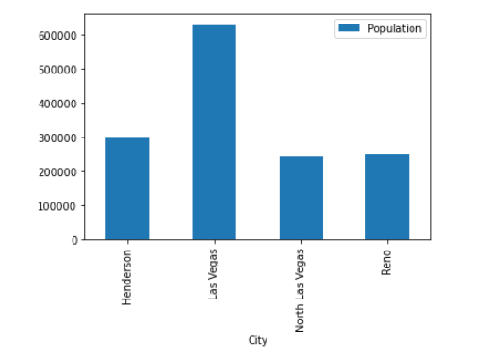
Nevada four cities population

Slide 6
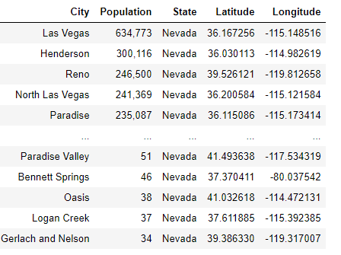
Cities coordinates

Slide 7
Cities coordinates and population

Slide 8
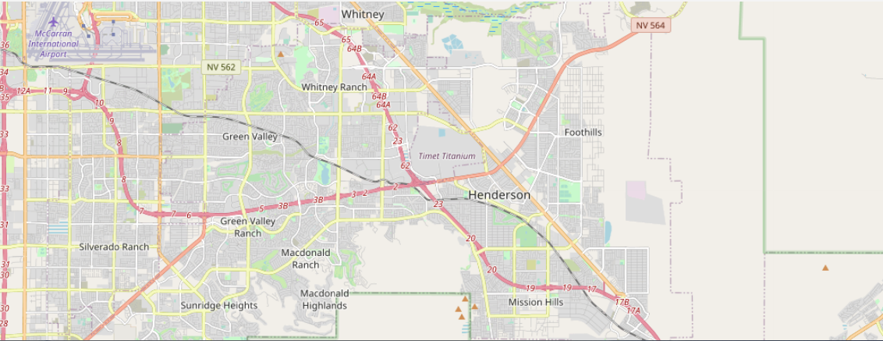
Henderson Neighborhoods Map
Henderson city with 41 neighborhoods

Slide 9
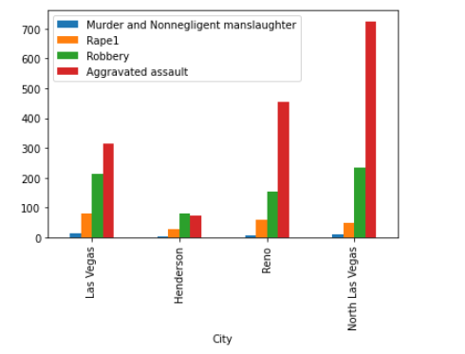
Violent crimes

Slide 10
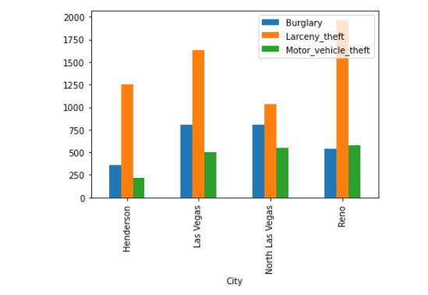
Property crimes

Slide 11
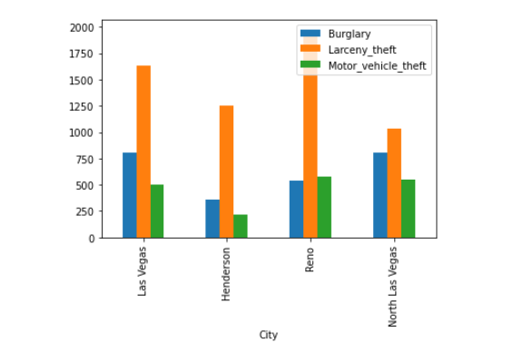
Arson crime

Slide 12
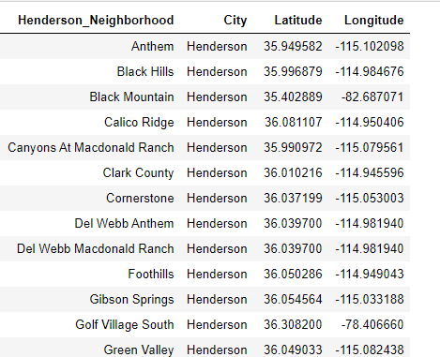
Henderson neighborhoods coordinates

Slide 13
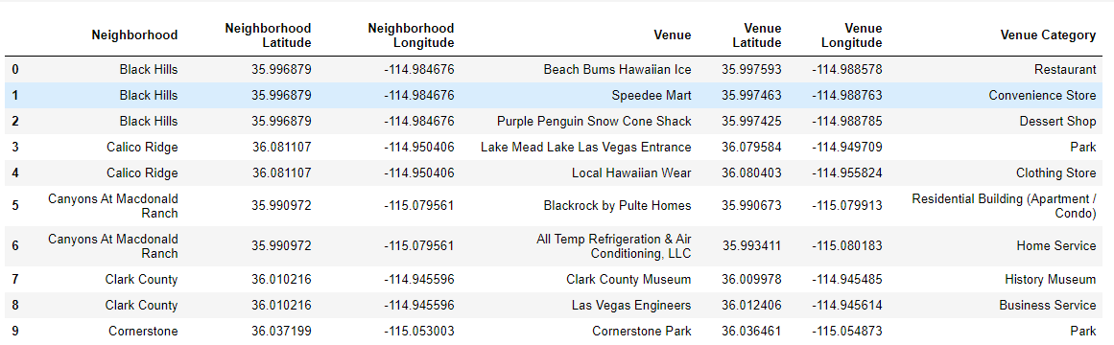
Neighborhoods venues

Slide 14
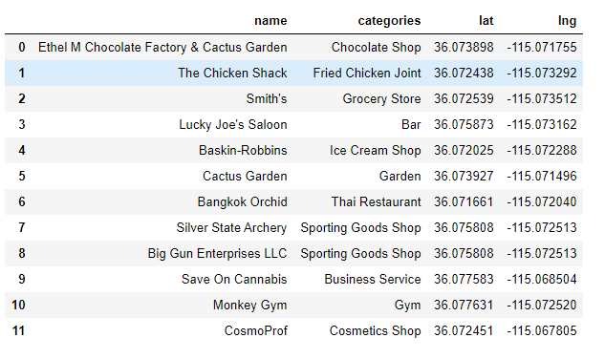
Whitney neighborhood venues

Slide 15
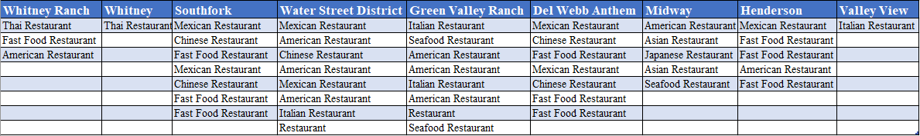
Restaurants in most populous neighborhoods

Slide 16
Conclusion
In this study, I analyzed the states in different cities in Nevada based on the crime data provided in report. I managed to check for security in different cities in Nevada based on population, types of crimes that can be obstacle for business like restaurant.
Based on the data provided by foursquare I located different venues in different cities and that gave image of the place and type of business that can be proposed and more interestingly to restaurant business. Nevada is a good place for business as it is more secure compare to the other city in United States considering the crimes rates presented.
Restaurants are rare in Henderson especially in Whitney neighborhood where it is only Tai restaurant. I recommend Whitney because no problem of competitors, any type of restaurant is profitable. Henderson neighborhood is also a key point to set the business because is more populous, but it has small number of restaurants. I also recommend Henderson city for stakeholders who want to do business in the place which is secure.

